Slide 1
Vector

Slide 2
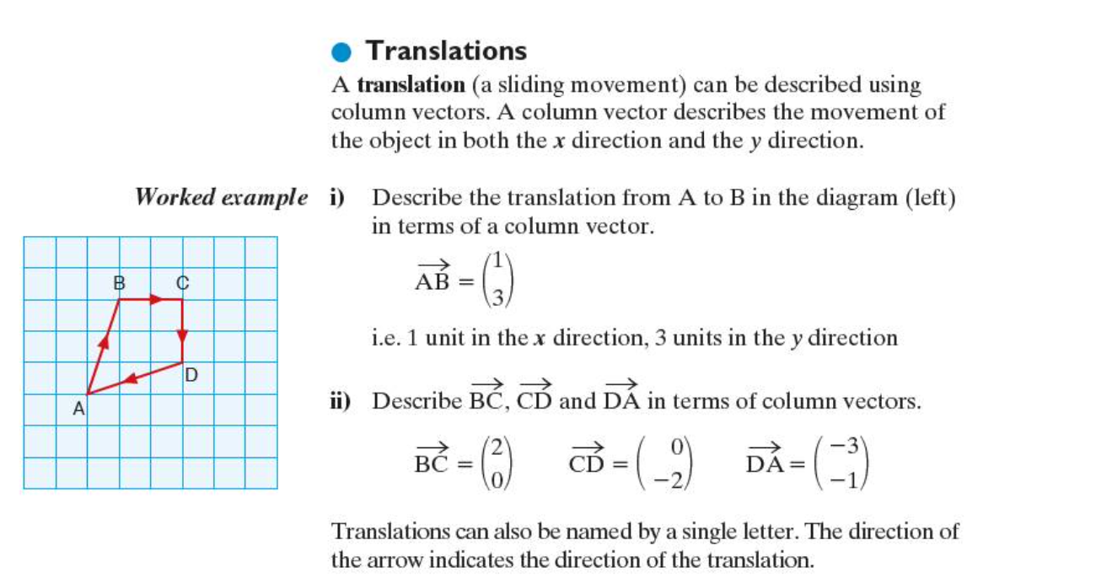
Translation

Slide 3
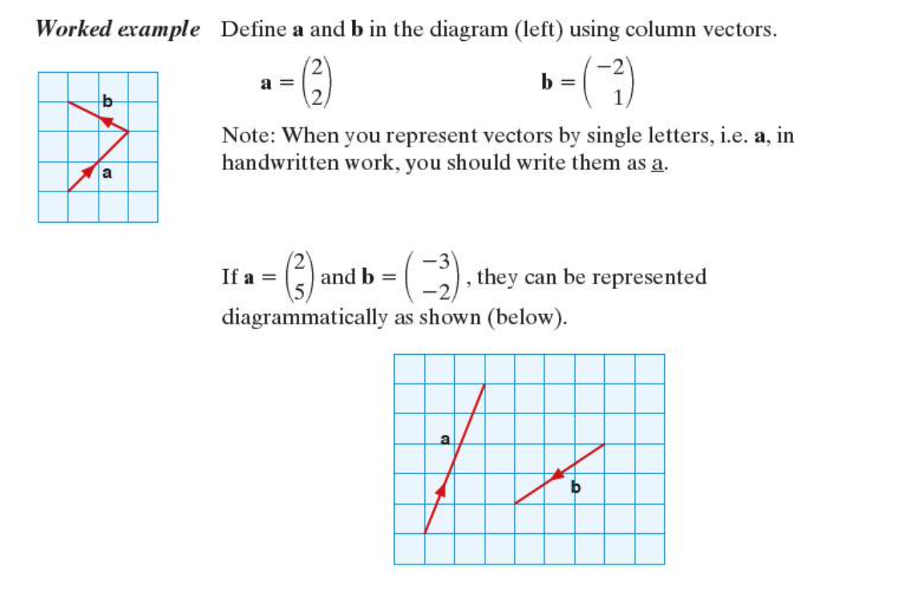

Slide 4
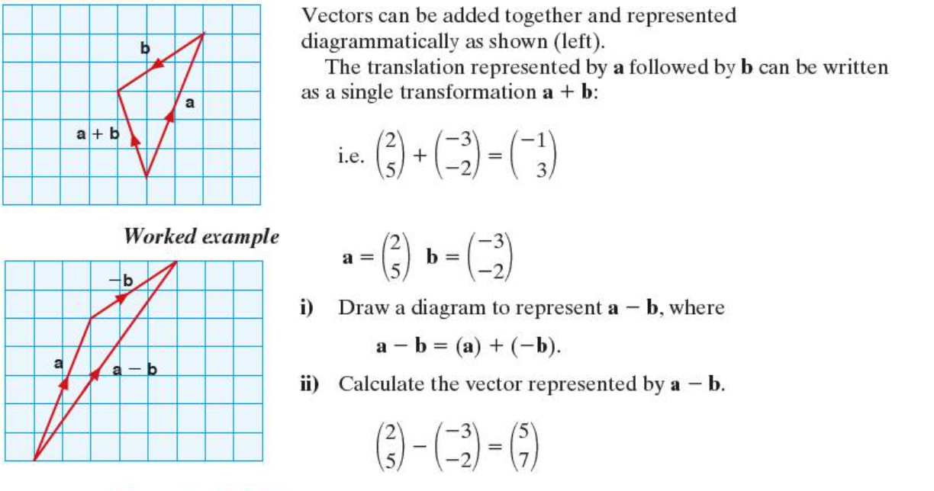
Addition and subtraction of vectors

Slide 5
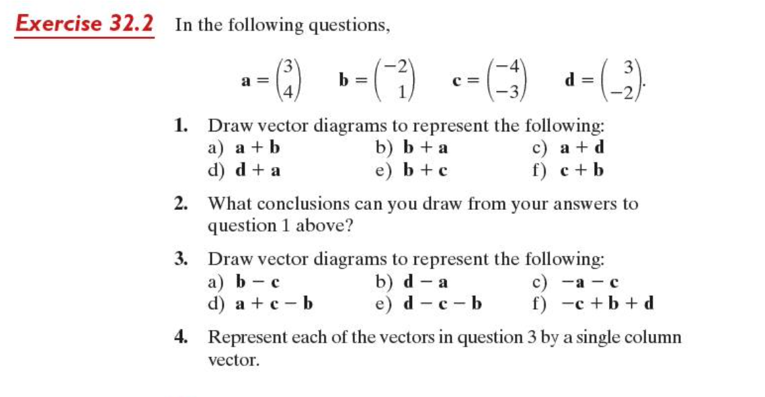

Slide 6

Multiplying a vector by a scalar

Slide 7
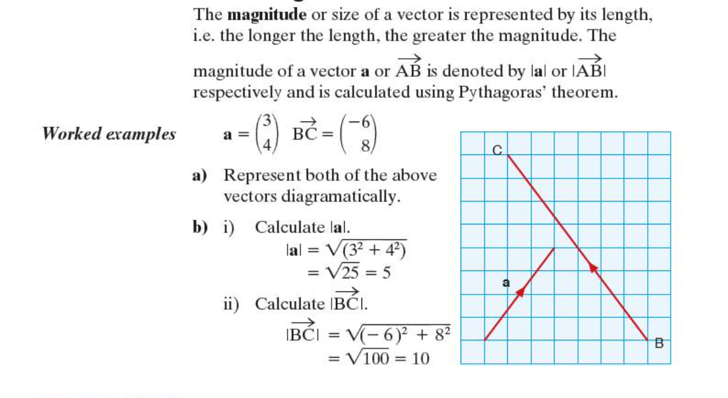
The magnitude of a vector

Slide 8
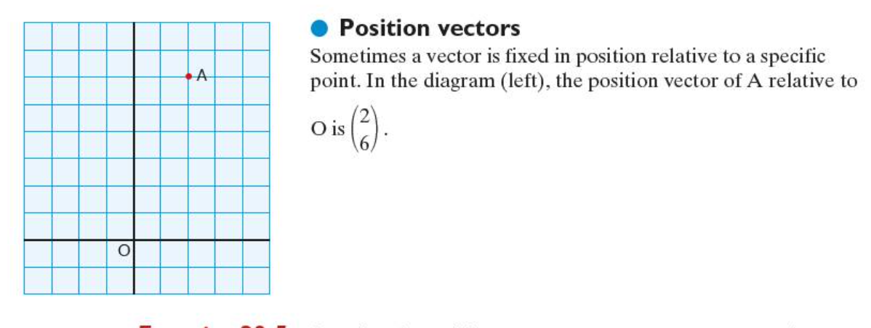
Position Vectors

Slide 9
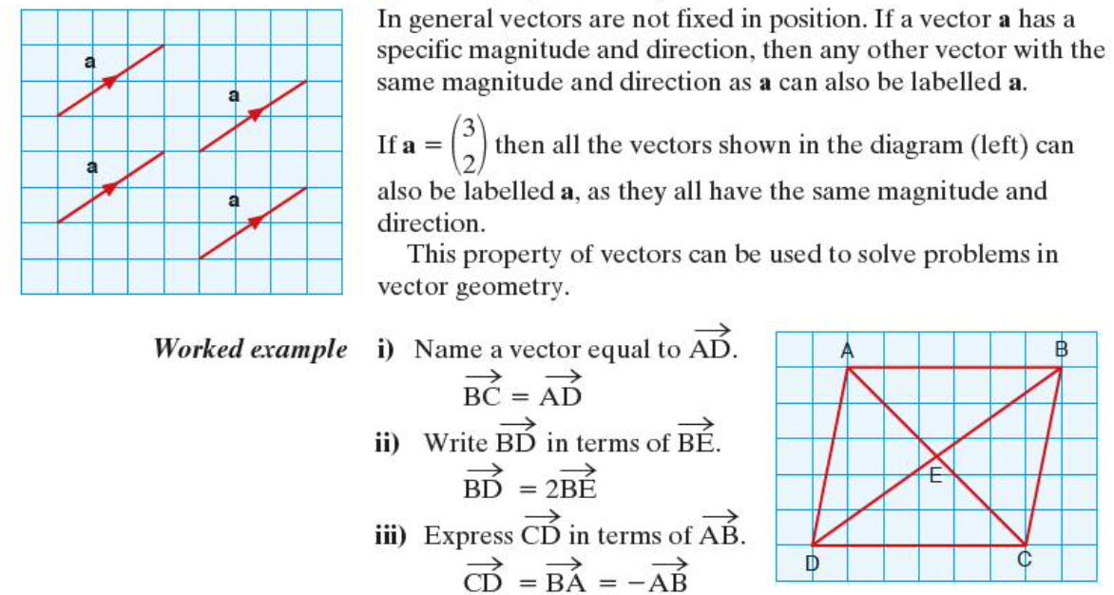
Vector Geometry

Slide 10
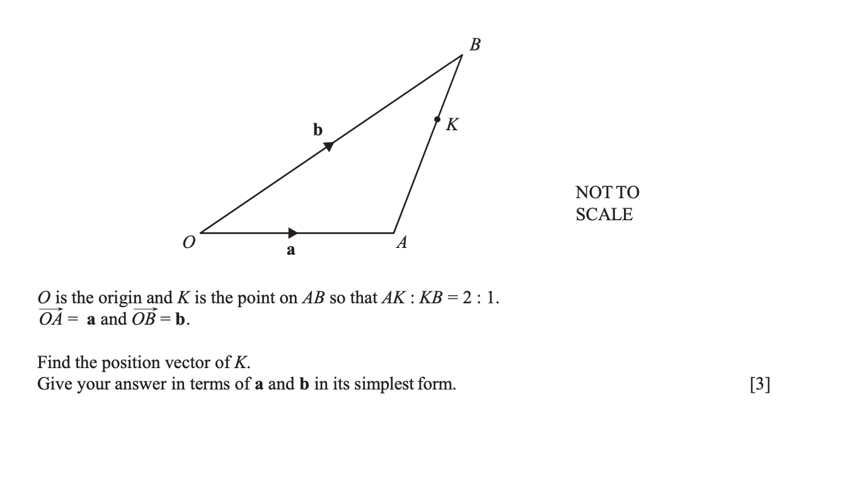

Slide 11
